Slide 1
Queue Management

Slide 2
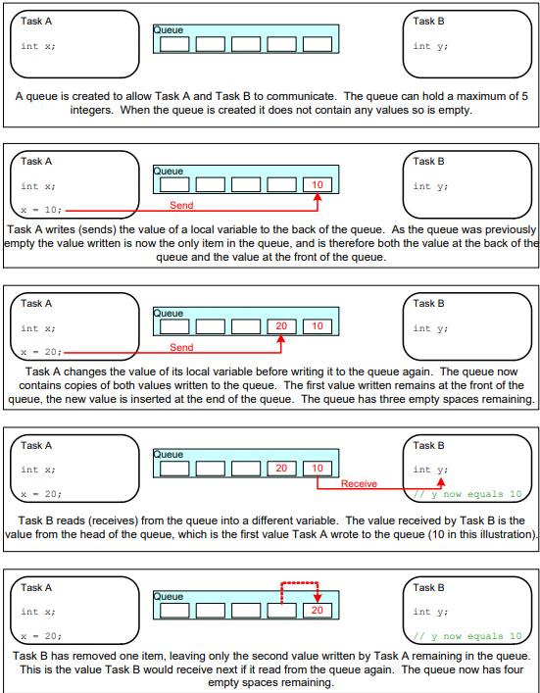
Overview
A queue hold a finite number of fixed size data items.
Queues are normally used as First In First Out (FIFO) buffers, where data is written to the end (tail) of the queue and removed from the front (head) of the queue.
It could be possible to write the front of a queue, and to overwrite data that is already at the front of a queue.
Queues provide a task-to-task, task-to-interrupt, and interrupt-to-task communication mechanism.

Slide 3
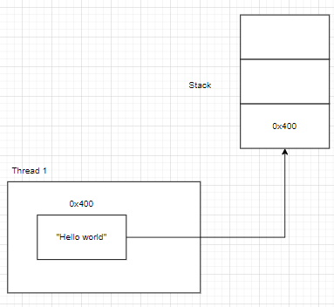
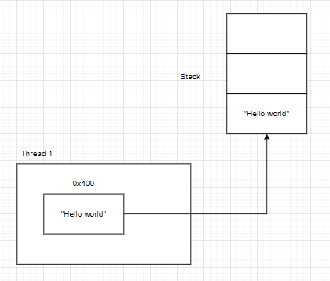
Data Types of Queue
Queue by reference
Queuing by reference means the queue only holds pointers to the data sent to the queue, no the data itself
Queue by copy
Queuing by copy means the data sent to the queue is copied byte for byte into the queue
Queue by reference
Queue by copy

Slide 4
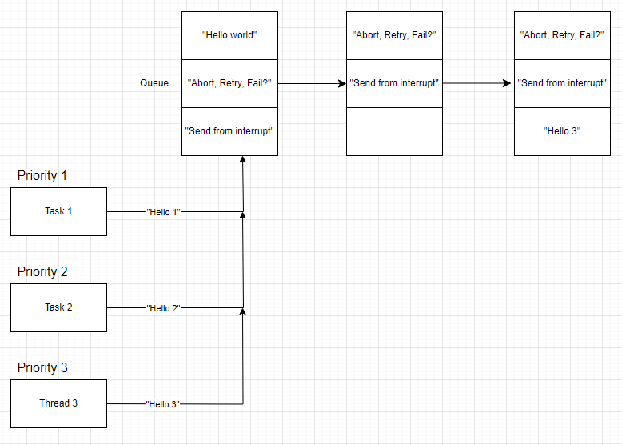
Queue Read-Write Blocking
Blocking on Queue Reads
Could optionally specify a “block” time
A Task will be in Blocked state if there are no available data
A task will move to Ready state if new data is placed into the queue
A task will also move to Ready state if the “block” time expires before data become available
When multiple task reads on the same queue, the highest priority task will be proceeded first. If there are same priority tasks, the longest waiting task will be proceeded
Blocking on Queue Writes
Block time for waiting for available space to write to a queue.
The highest priority task will proceed first after space is available to write.
If tasks are the same priority, the longest waiting task will proceed
Queue Writing Example

Slide 5
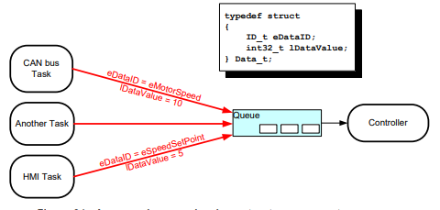
Event-driven Application With Queue
This is called event paradigm. A queue holds data structures of type Data_t. The type Data_t stores eventID for indicating the meaning of data and lDataValue for data value.
A central Controller task handles the system state change based on eventID.

Slide 6
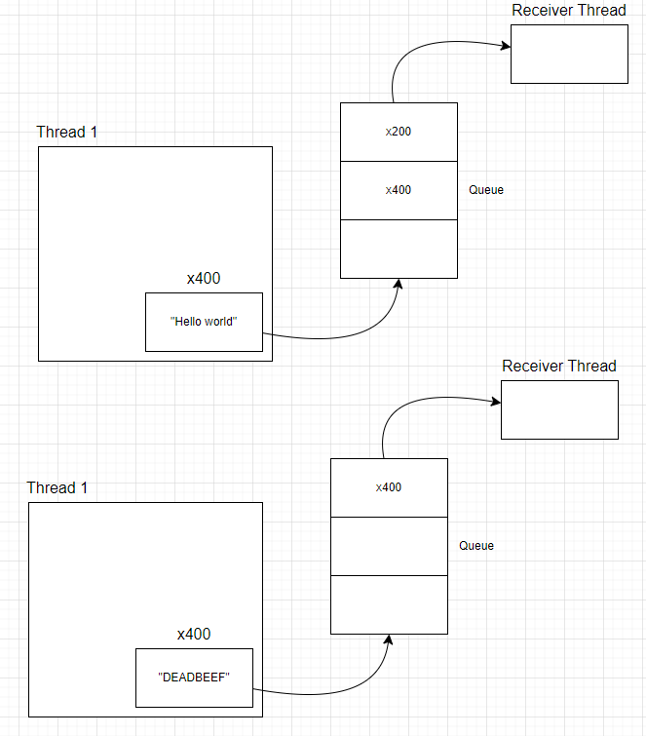
Working with Large or Variable Sized Data
If the size of the data being stored in the queue is large, then queue by reference is a good choice.
However, extreme care must be taken to ensure that:
The owner of the RAM being pointed is clearly defined. Both tasks do not modify the memory contents, which could cause the memory contents to be invalid or inconsistent.
The RAM being pointed to remains valid. If the memory being pointed to was allocated dynamically, then it should not be freed when in the queue. A pointer should never be used to access data that has been allocated on task stack. The data will not be valid after the stack frame has changed.

Slide 7
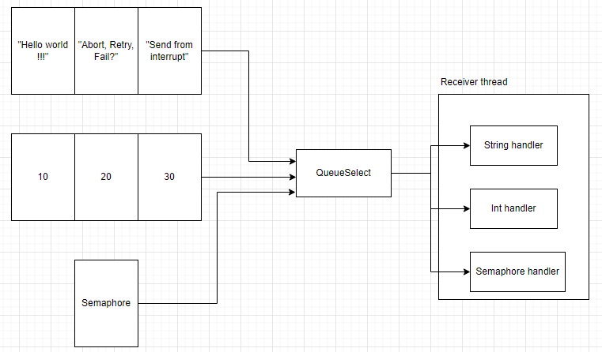
Receiving From Multiple Queues
Application design require a single task to receive data of different sizes, data of different meaning, and data from different sources.
Queue set in freeRTOS allows a task to receive data from many queues without the task polling each queue in turn to determine which contains data
However, a design that uses a queue set to receive data from multiple sources is less neat, and less efficient than event-driven design.

Slide 8
Resource Management

Slide 9
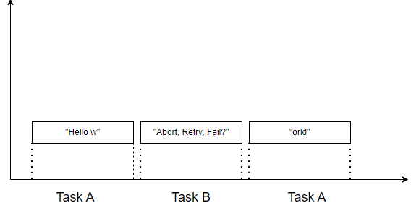
Unwanted Cases
Accessing a Peripheral

Slide 10
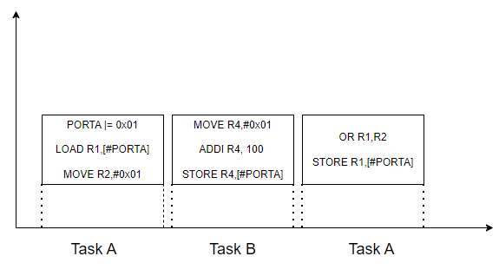
Unwanted Cases
Read, Modify, Write Operations

Slide 11
Mutual Exclusion
To ensure data consistency is always maintained access to a resource that is shared between tasks, or between tasks and interrupts
The best mutual exclusion method is to design the application in such a way that resources are not shared, and each resource is accessed only from a single task.
Mutual Exclusion techniques:
Critical section
Suspended Tasks
Mutexes
Semaphores

Slide 12
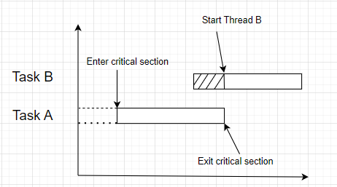
Critical Section
It works by disabling interrupts, either completely, or up to specific interrupt priority level
The task called to enter critical section (use taskENTER_CRITICAL() api) is guaranteed to remain in the Running state until the critical section is exited (use taskExit_CRITICAL())
Critical sections must be kept very short, otherwise they will adversely affect interrupt response times.
To access critical section in an interrupt service routine, taskENTER_CRITICAL_FROM_ISR() and taskEXIT_CRITICAL_FROM_ISR() could be used for interrupt safe equivalents

Slide 13
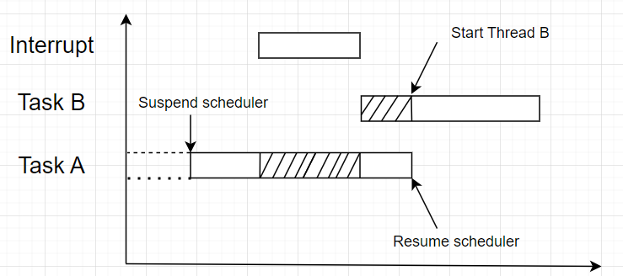
Suspending (or Locking) The Scheduler
A critical section implemented by suspending the scheduler only protects a region of code from accessing by other tasks
A critical section takes too long to implement than because of disabling interrupts
But if interrupt activities happen, it will make the task run relatively long

Slide 14
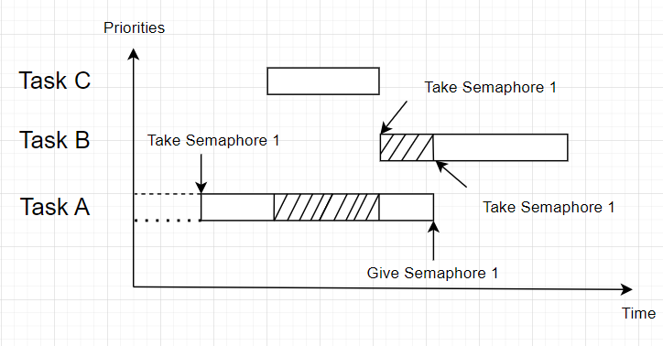
Mutexes (and Binary Semaphores)
The word MUTEX originates from “MUTual EXsclusion”. It’s a special type of binary semaphore that is used to control access to a resource that is shared between two or more tasks.

Slide 15
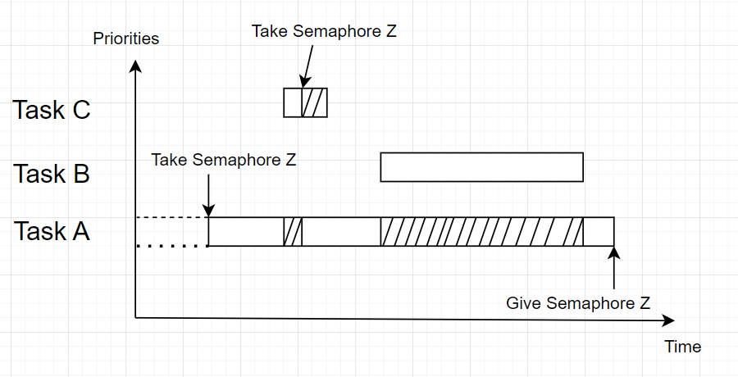
Priority Inversion
A higher priority task will be being delayed by a lower priority task when they are using the same mutex

Slide 16
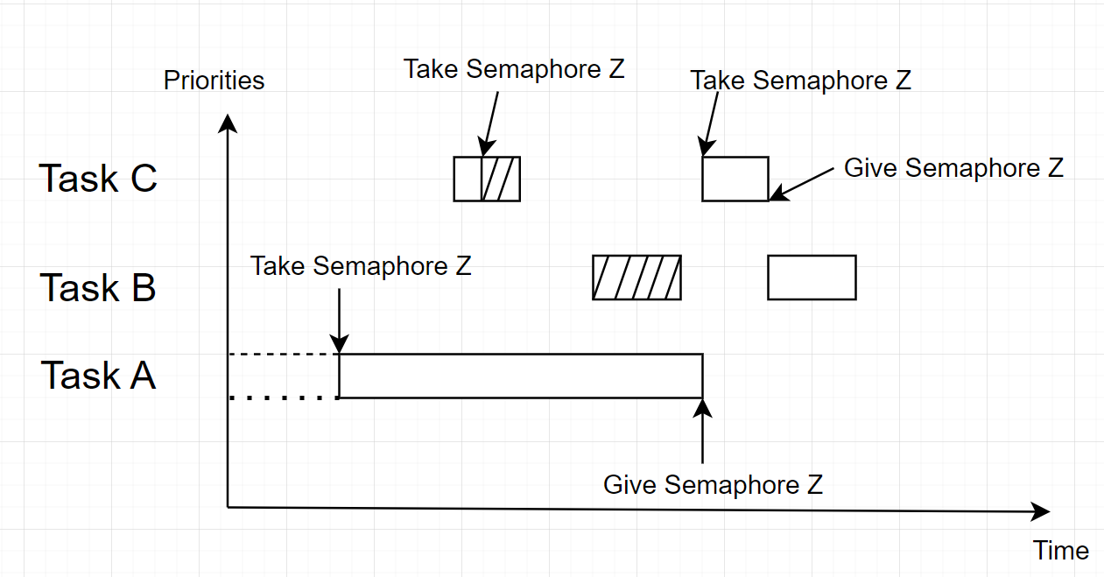
Priority Inheritance
Only mutex in FreeRTOS includes a basic ‘priority inheritance’
Priority inheritance minimizes the negative effects of priority inversion. Switch a priority of a low-level current task to the priority of a higher task which are waiting for mutex to be given. So, the tasks whose priority is in the middle of the low-level one and the waiting higher task could not pre-empt.
However, priority inheritance complicates system timing analysis, and it is not good practice to rely on it for correct system operation

Slide 17
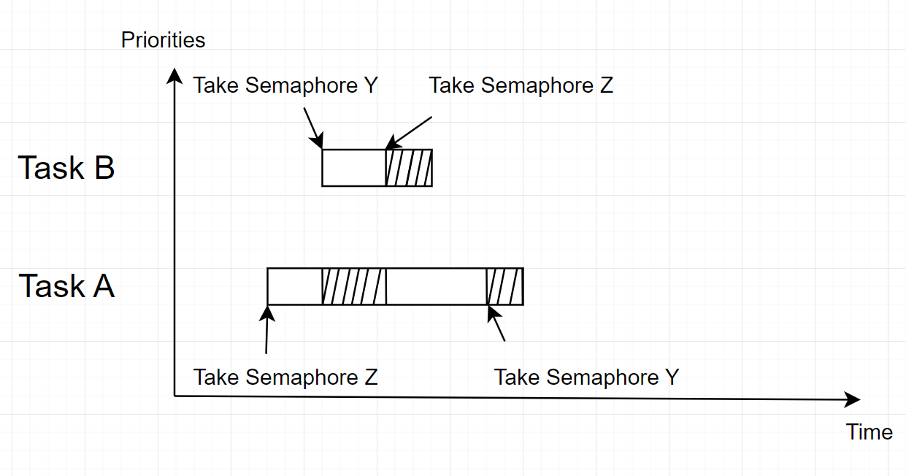
Deadlock (or Deadly Embrace)
Deadlock occurs when two tasks cannot proceed because they are both waiting for a resource that is held by the other.
In practice, deadlock is not a big problem in small embedded systems, because the system designers can have a good understanding of the entire application, and so can identify and remove the areas where it could occur

Slide 18
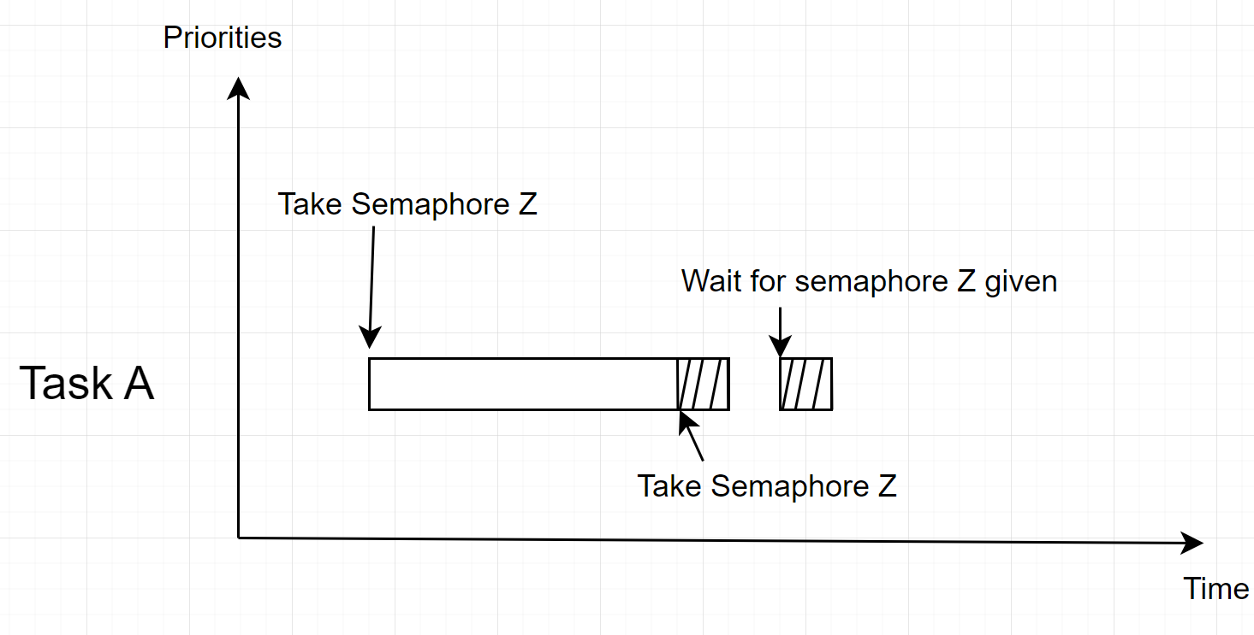
Recursive Mutexes
It is also possible for a task to deadlock itself, which will happen if a task attempts to take the same mutex more than once. For example,
A task successfully obtains a mutex
While holding the mutex, the task calls a library function
The implementation of the library function attempts to take the same mutex, and enters the Blocked state to wait for the mutex to become available
A Recursive mutex resolved this situation by allowing to call many times in the same task.

Slide 19
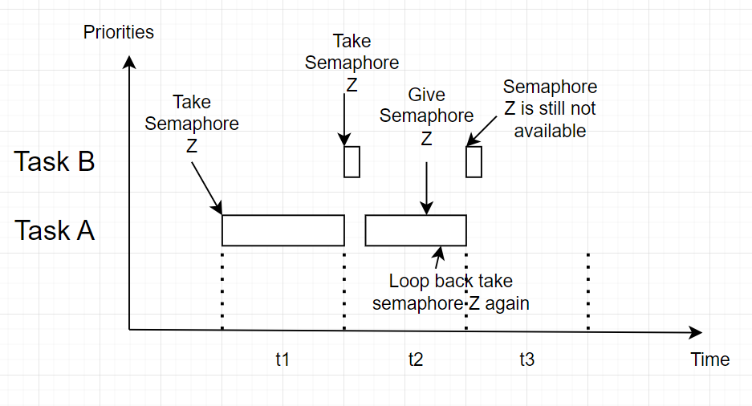
Mutexes and Task Scheduling
There is a flaw in the tasks in time-slicing mode or have the same priorities.
A situation happens when task A take a semaphore Z before task B. When the semaphore given, task B is still not in turn to run. Task A takes semaphore again. If this happens continuously, task B will barely have the chance to complete its program
This scenario can be avoided by adding a call to taskYIELD() after the call to xSemaphorGive(). It will request a context switch to another task, if there are no other tasks at a higher or equal priority to the task that calls taskYIELD() then RTOS scheduler will simply select the task tat called taskYIELD() to run again

Slide 20
Gatekeeper Tasks
Gatekeeper tasks provide a clean method of implementing mutual exclusion without the risk of priority inversion or deadlock
Only the gatekeeper task is allowed to access the resource directly – any other task needing to access the resource can do so only indirectly by using the services of the gatekeeper
It’s like event-driven paradigm, the gatekeeper task will be in blocked mode if there are no messages to send out. It uses a FreeRTOS queue to serialize access to standard out. Other tasks or ISRs want to send a message to serial, they must put their message to the queue.

Slide 21
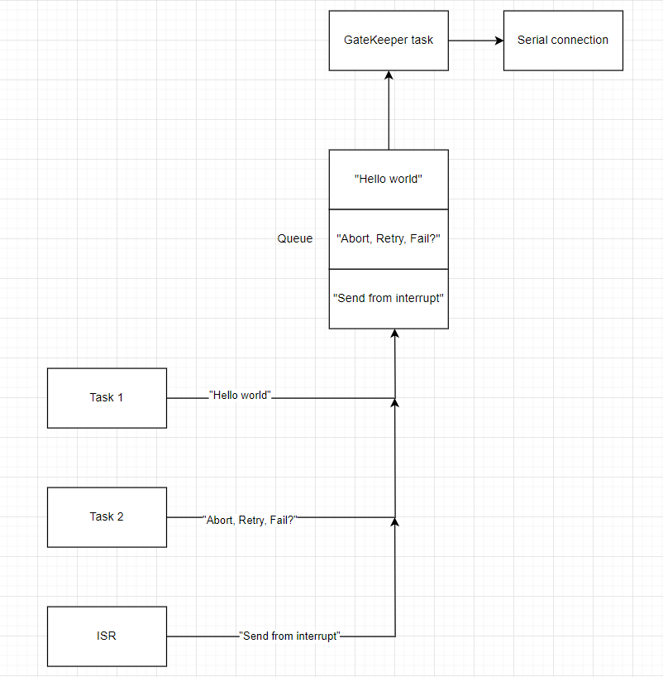
Gatekeeper Tasks

Slide 22
FreeRTOS Example

Slide 23
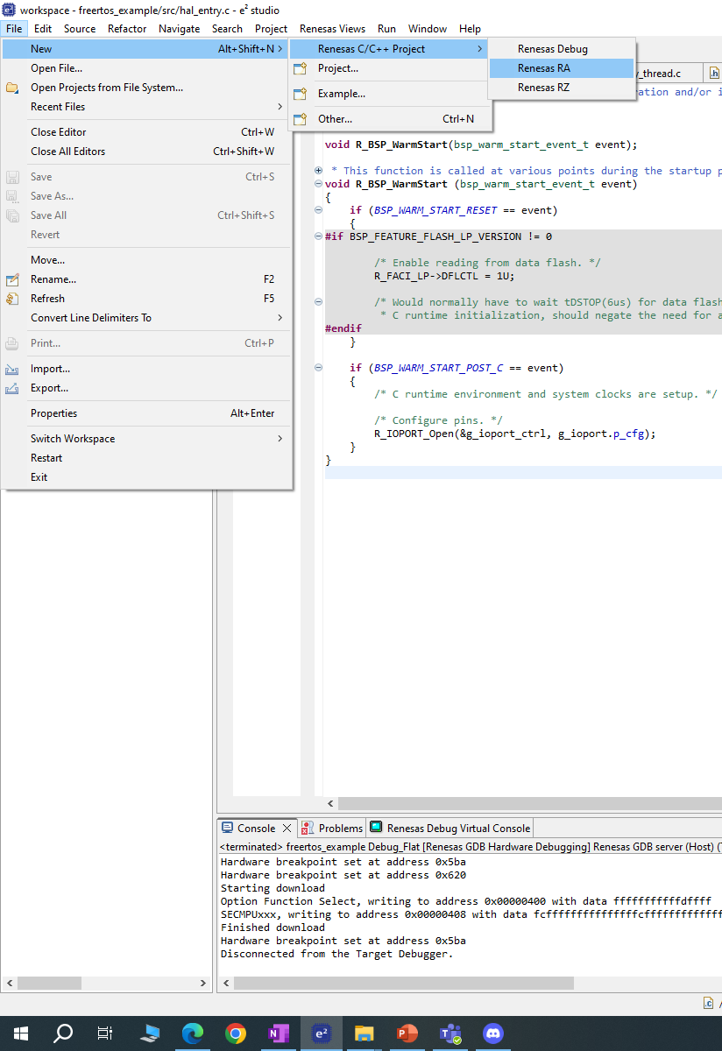
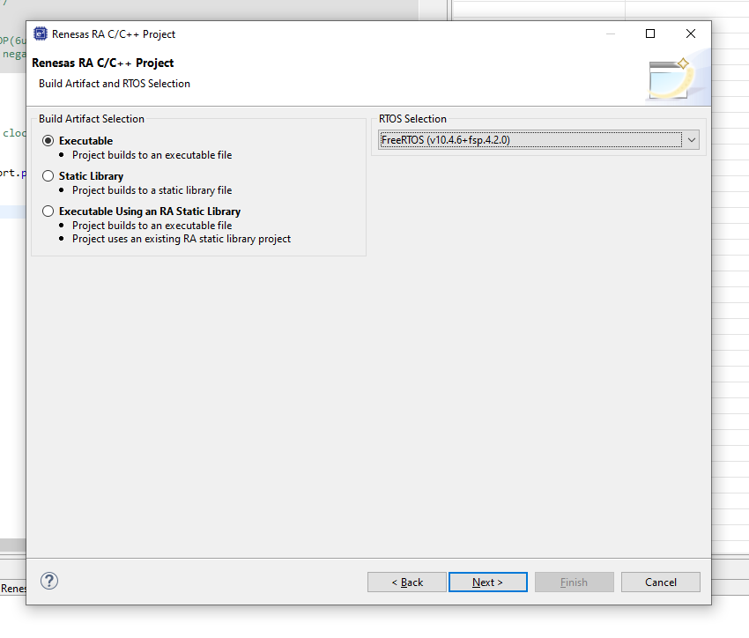
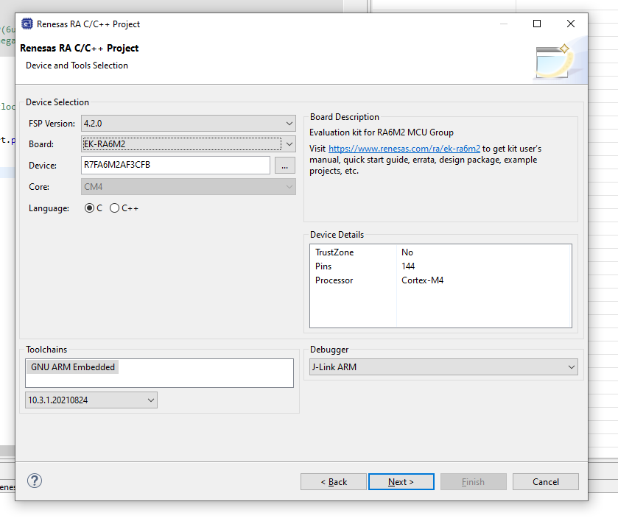
Create New Project

Slide 24
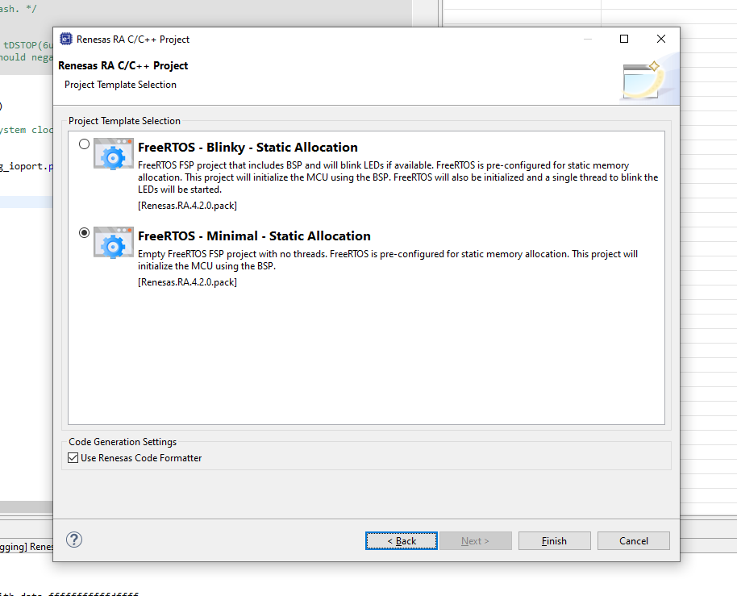
FreeRTOS Selection

Slide 25
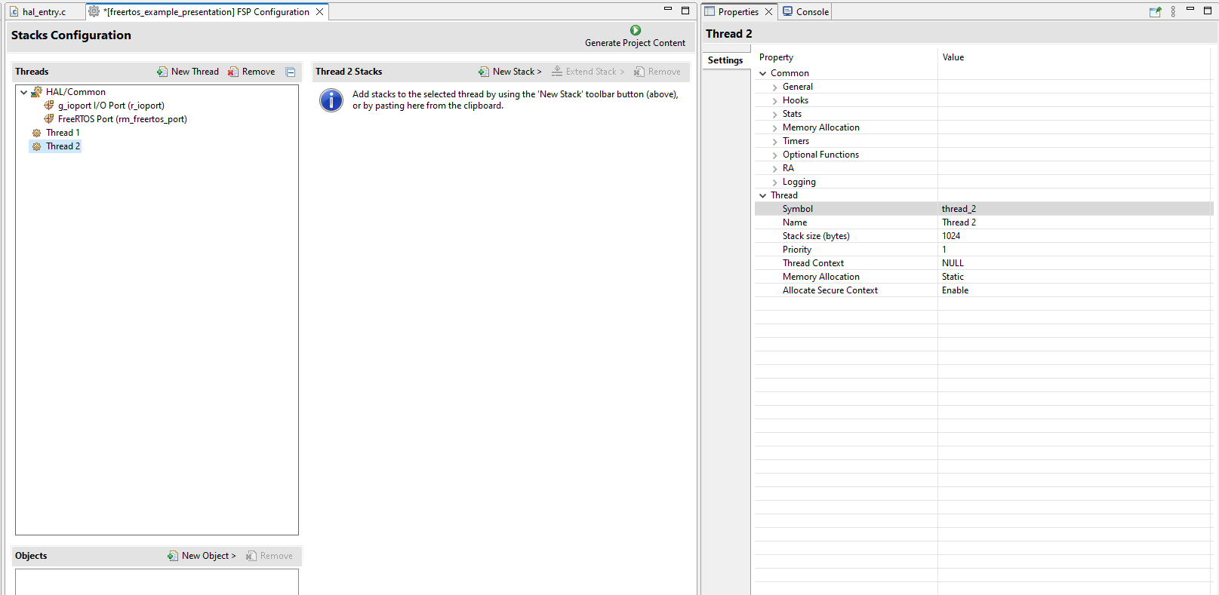
Create New Threads
1
2

Slide 26
Create New Threads
1
2

Slide 27
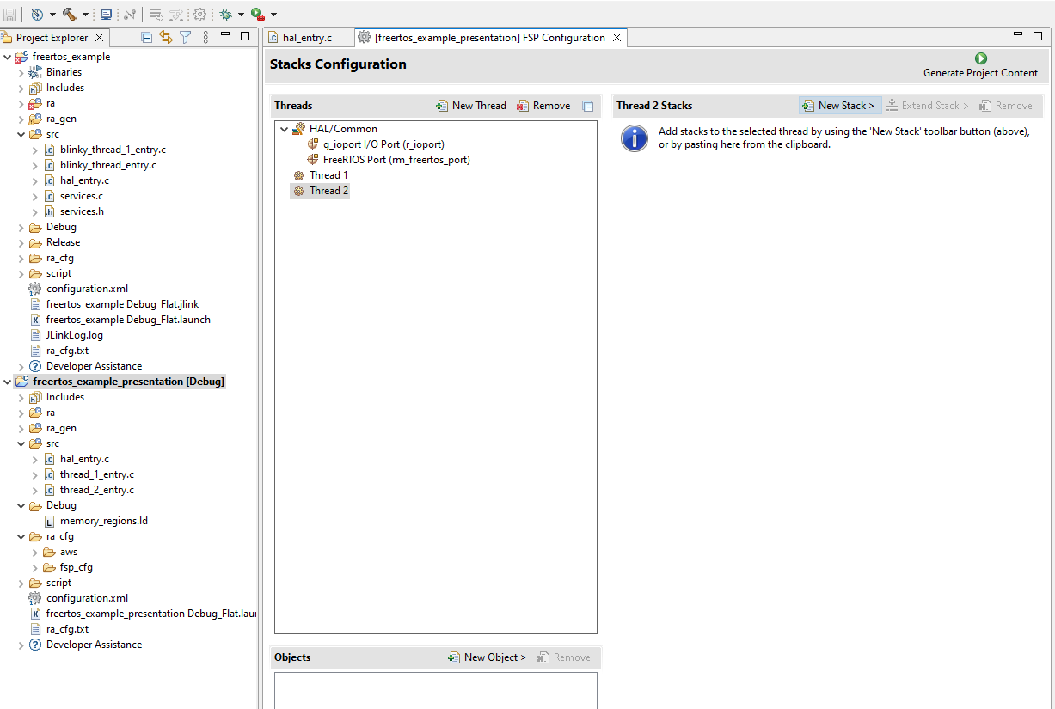
Generate Project Content

Slide 28
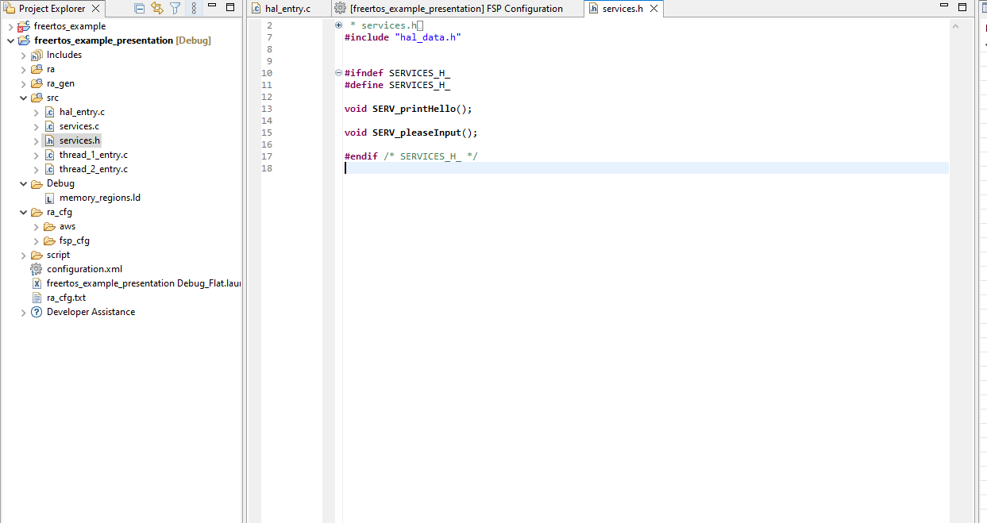
Create Services
To use common_data.h, stdint.h, bsp_api.h, include this in services.h

Slide 29
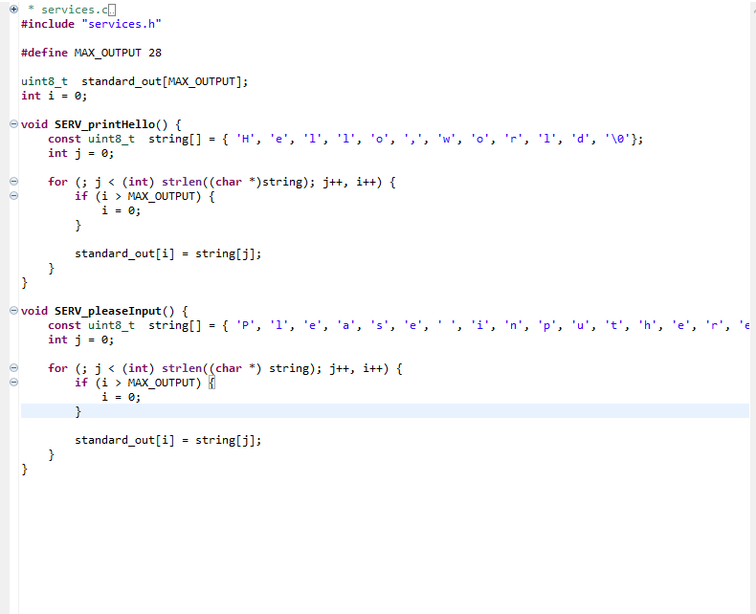
Service Implementation
Buffer simulates serial output
Service for thread 1 to print out string “Hello, world”
Service for thread 1 to print out string “Please input here”

Slide 30
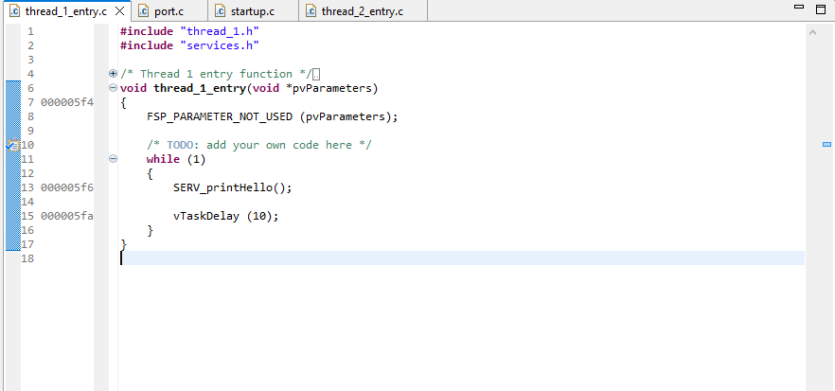
Service Implementation
Calling service SERV_printHello()
Put task into “Blocked” State in 10 ticks

Slide 31
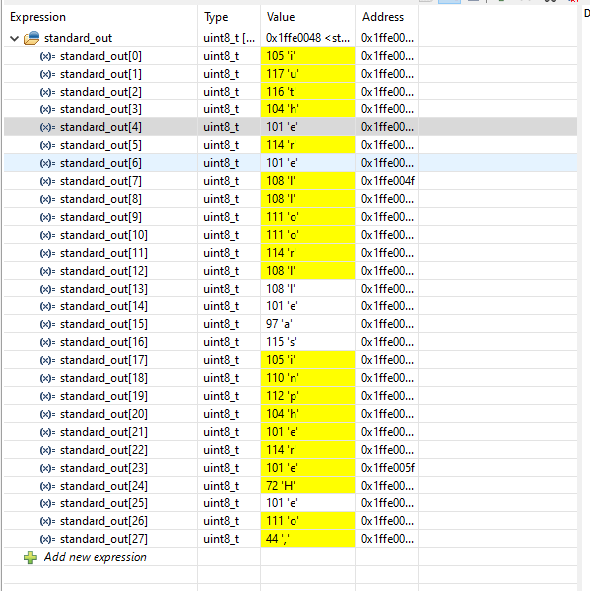
Data Collision

Slide 32
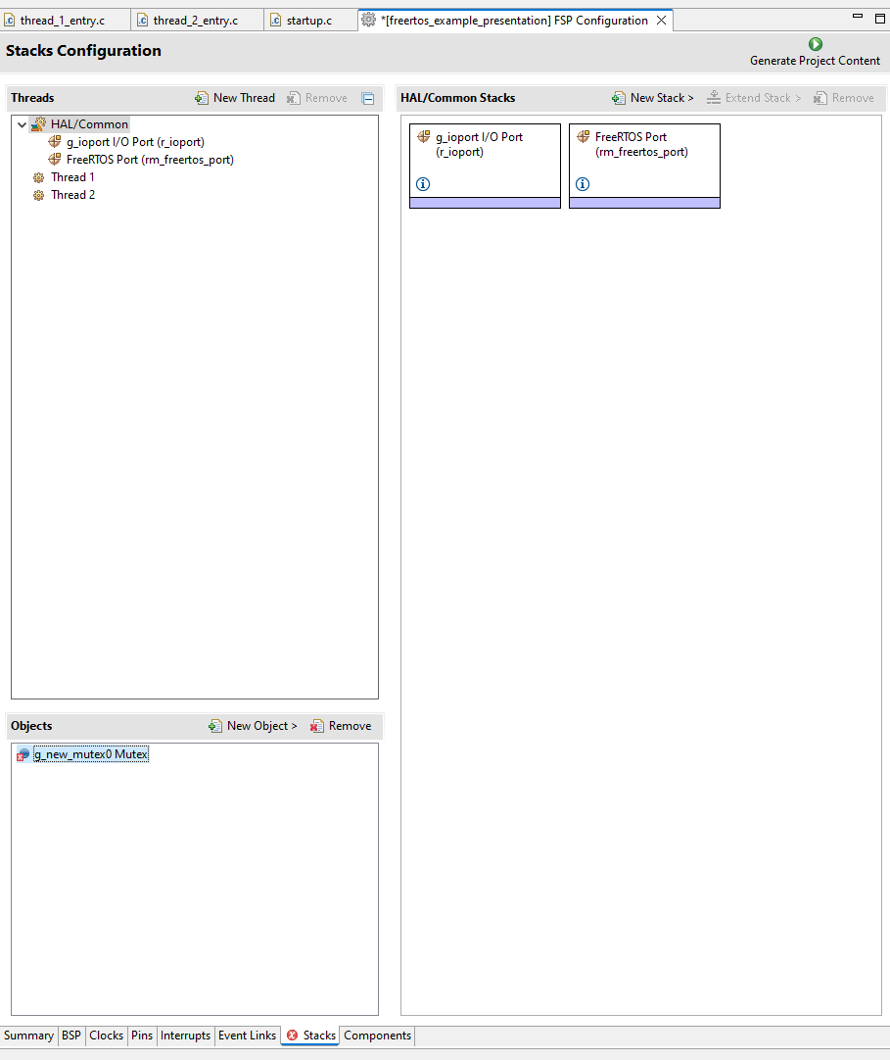
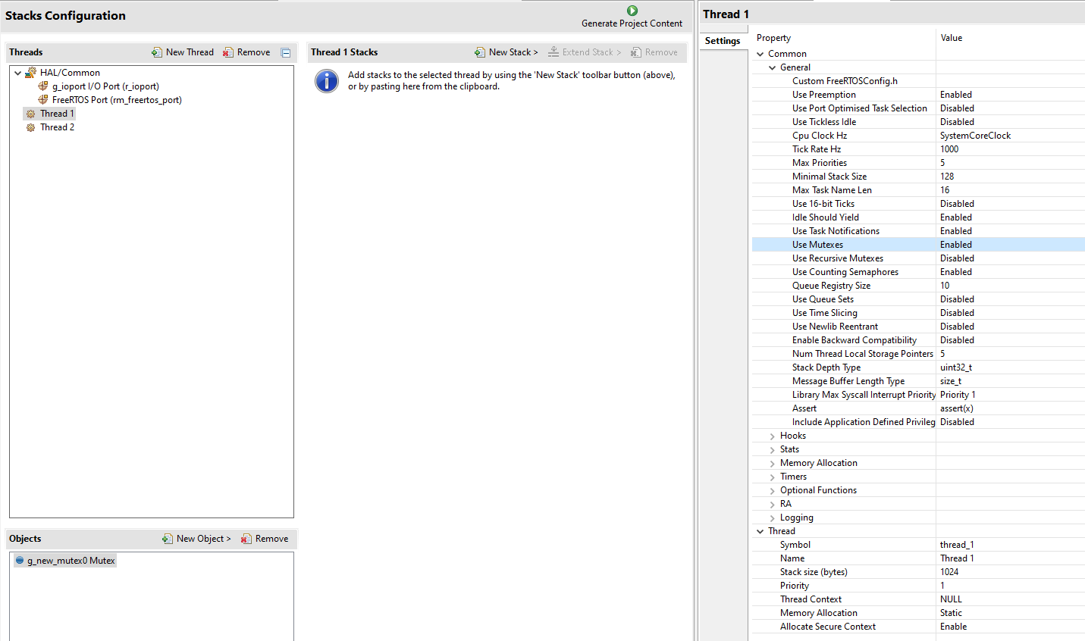
Mutex Implementation
Enable Mutex in Thread
1

Slide 33
Mutex Implementation
Enable Mutex in Thread
1

Slide 34
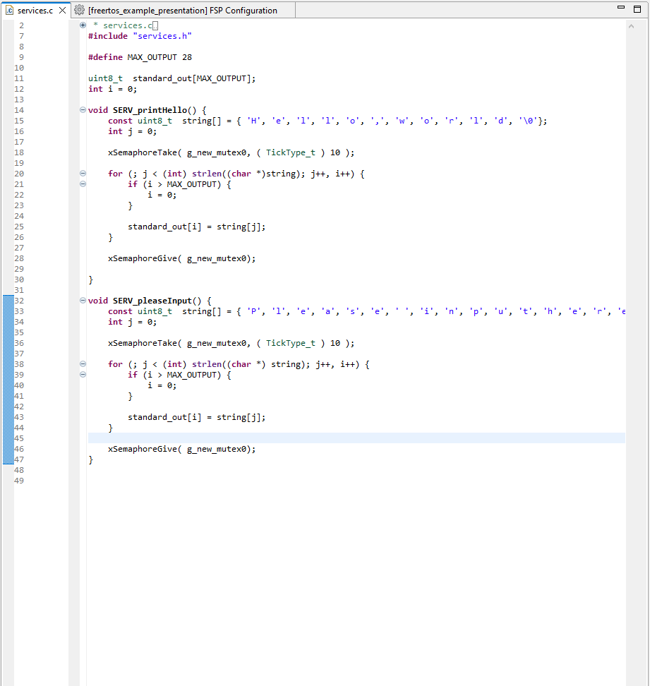
Mutex Implementation

Slide 35
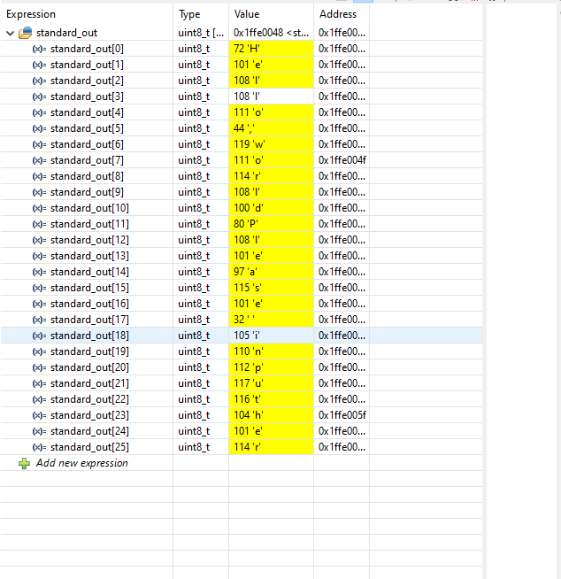
Mutex Implementation
Hello world
Please input here

